Slide 1
CS4038
DATA MINING
LECTURE # 23
SPRING 2024
FAST – NUCES, CFD CAMPUS
AYESHA LIAQAT
ayesha.liaqat@nu.edu.pk

Slide 2
TODAY’S TOPICS
Hierarchical Clustering
Agglomerative
Divisive
Dendrogram

Slide 3
HIERARCHICAL CLUSTERING

Slide 4
HIERARCHICAL CLUSTERING
Produces a set of nested clusters organized as a hierarchical tree
Can be visualized as a dendrogram
A tree like diagram that records the sequences of merges or splits
0.2
6
5
0.15
4
3
2
4
5
2
0.1
0.05
1
0
1
3
2
5
4
6
3
1

Slide 5
HIERARCHICAL CLUSTERING
Two main types of hierarchical clustering
Agglomerative:
Start with the points as individual clusters
At each step, merge the closest pair of clusters until only one cluster (or k clusters) left
Also known as AGNES (AGglomerative NESting)
Divisive:
Start with one, all-inclusive cluster
At each step, split a cluster until each cluster contains an individual point (or there are k clusters)
Also known as DIANA (DIvisive ANAlysis Clustering)
Traditional hierarchical algorithms use a similarity or distance matrix
Merge or split one cluster at a time

Slide 6
AGGLOMERATIVE CLUSTERING ALGORITHM
Key Idea: Successively merge closest clusters
Basic algorithm
Compute the proximity matrix
Let each data point be a cluster
Repeat
4.
5.
Merge the two closest clusters Update the proximity matrix
6. Until only a single cluster remains
Key operation is the computation of the proximity of two clusters
Different approaches to defining the distance between clusters distinguish the different algorithms

Slide 7

STEPS 1 AND 2
Start with clusters of individual points and a proximity matrix
p1 p2 p3 p4 p5
. .
p1
.
p2 p3
p4
p5
.
.
.
Proximity Matrix
...
p1
p2
p3
p4
p9
p10
p11
p12

Slide 8
INTERMEDIATE SITUATION
 | C1 | C2 | C3 | C4 | C5
C1
C2
C3
C4
C5
After some merging steps, we have some clusters
C 3
C
4
C 1
Proximity Matrix
C 2
C 5
...
p1
p2
p3
p4
p9
p10
p11
p12

Slide 9




STEP 4
We want to merge the two closest clusters (C2 and C5) and update the proximity matrix.
C 3
C
4
 | C1 | C2 | C3 | C4 | C5
C1
C2
C3
C4
C5
Proximity Matrix
C 1
C 2
C 5
...
p1
p2
p3
p4
p9
p10
p11
p12

Slide 10

STEP 5
The question is “How do we update the proximity matrix?”
C2
U
 | C1 | C5 | C3 | C4
C1 |  | ?
C5 | ? | ? | ? | ?
C3 |  | ?
C4 |  | ?
C 3
C2 U
C 4
C 1
Proximity Matrix
C2 U C5
...
p1
p2
p3
p4
p9
p10
p11
p12

Slide 11
HOW TO DEFINE INTER-CLUSTER DISTANCE
 | p1 | p2 | p3 | p4 | p5 | .
p1
p2
p3
p4
p5
.
. .
Similarity?
MIN
MAX
Group Average
Distance Between Centroids
Other methods driven by an objective function
– Ward’s Method uses squared error
.
.
Proximity Matrix

Slide 12
HOW TO DEFINE INTER-CLUSTER DISTANCE
 | p1 | p2 | p3 | p4 | p5 | .
p1
p2
p3
p4
p5
.
. .
!
MAX
Group Average
Distance Between Centroids
Other methods driven by an objective function
– Ward’s Method uses squared error
MIN
.
.
Proximity Matrix
12
Notes:
the shortest distance between any two points in the two clusters. Elongated shapes clusters
Good for sparse data, chain like structure, sequential data, datasets with complex cluster boundaries

Slide 13
HOW TO DEFINE INTER-CLUSTER DISTANCE
 | p1 | p2 | p3 | p4 | p5 | .
p1
p2
p3
p4
p5
.
. .
MIN
!
Group Average
Distance Between Centroids
Other methods driven by an objective function
– Ward’s Method uses squared error
MAX
.
.
Proximity Matrix
13
Notes:
Compact, spherical clusters. Less sensitive to noise and outliers, capture overall struct of the data.

Slide 14
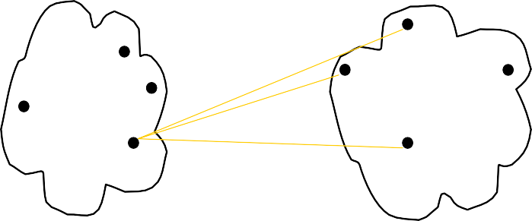
HOW TO DEFINE INTER-CLUSTER DISTANCE
 | p1 | p2 | p3 | p4 | p5 | .
p1
p2
p3
p4
p5
.
. .
MIN
MAX
!
Distance Between Centroids
Other methods driven by an objective function
– Ward’s Method uses squared error
Group Average
.
.
Proximity Matrix
14

Slide 15
HOW TO DEFINE INTER-CLUSTER DISTANCE
 | p1 | p2 | p3 | p4 | p5 | .
p1
p2
p3
p4
p5
.
. .
×
×
MIN
MAX
Group Average
!
Other methods driven by an objective function
– Ward’s Method uses squared error
Distance Between Centroids
.
.
Proximity Matrix

Slide 16
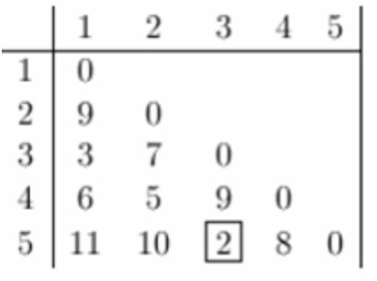
EXAMPLE
Let’s assume the input data contains 5 points.
The dissimilarity matrix is given on the left.
Since the cluster 3 and 5 have minimum dissimilarity, so we will first merge them together.
Let’s suppose we want to follow the “Max” (or Complete linkage) method to merge the clusters.

Slide 17
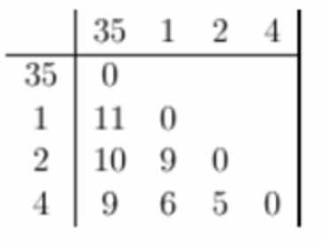
EXAMPLE
Now, we have four clusters in total to be merged.
Which clusters should be merged next?
Repeat this process until you are left with only one cluster.

Slide 18
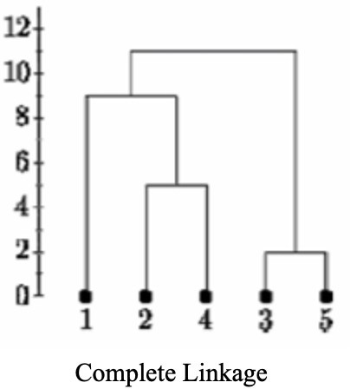
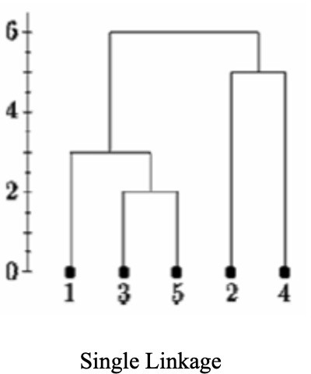
EXAMPLE: DENDROGRAM SOLUTION
Ref: https://online.stat.psu.edu/stat555/node/86/

Slide 19
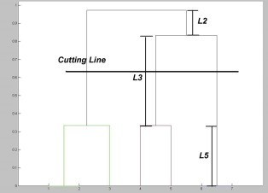
HIERARCHICAL CLUSTERING
Dendogram cut-off

Slide 20
READING MATERIAL
Chapter 9:Tan, Steinbach & Kumar
Chapter 10: Han, Kamber & Pei
Articles on Hierarchical clustering:
https://www.kdnuggets.com/2019/09/hierarchical-clustering.html
https://towardsdatascience.com/machine-learning-algorithms-part-12-hierarchical- agglomerative-clustering-example-in-python-1e18e0075019
36

